Slide 1


Titolo presentazione sottotitolo
Power Network System
Project for the course of Networked Control
Group members: Maggi Donatello
Marino Davide
Spinelli Nicolò
Milano, XX mese 20XX

Slide 2
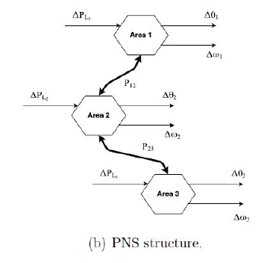
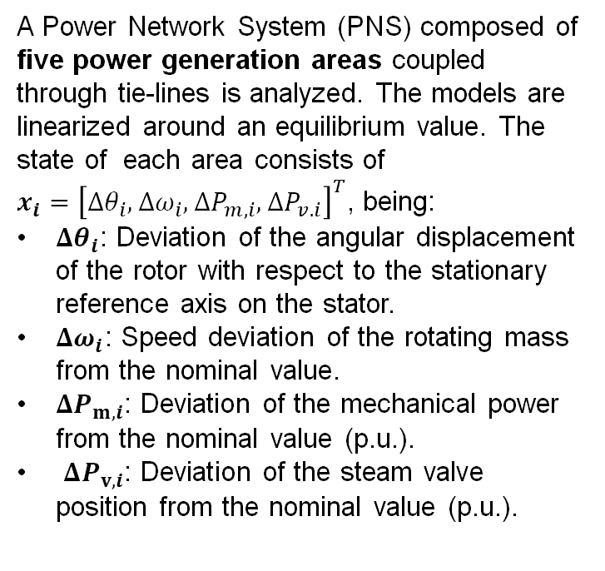
System description and initial analisys I
A Power Network System (PNS) composed of five power generation areas coupled through tie-lines is analyzed. The models are linearized around an equilibrium value. The state of each area consists of
$x_{i}={\left[Δθ_{i}, Δω_{i}, ΔP_{m,i}, ΔP_{v.i}\right]}^{T}$, being:
$Δθ_{i}$: Deviation of the angular displacement of the rotor with respect to the stationary reference axis on the stator.
$Δω_{i}$: Speed deviation of the rotating mass from the nominal value.
$ΔP_{m,i}$: Deviation of the mechanical power from the nominal value (p.u.).
$ΔP_{v,i}$: Deviation of the steam valve position from the nominal value (p.u.).

Slide 3

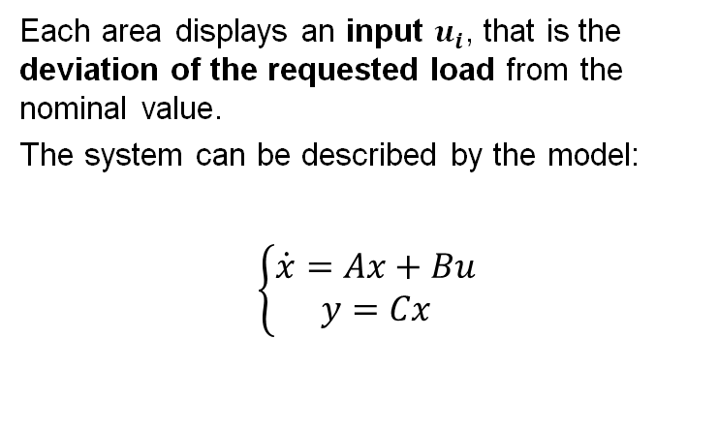
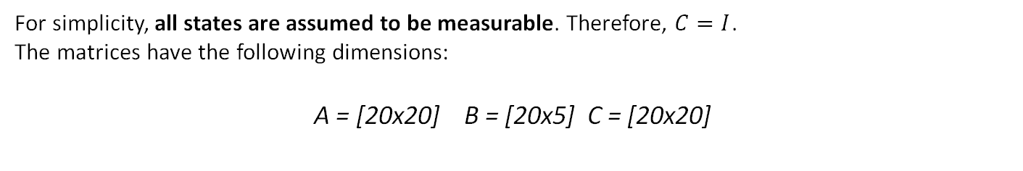
System description and initial analisys II
Each area displays an input $u_{i}$, that is the deviation of the requested load from the nominal value.
The system can be described by the model:
$\left\{\begin{aligned}\dot{x}=Ax+Bu \\ y=Cx\end{aligned}\right.$
For simplicity, all states are assumed to be measurable. Therefore, $C=I$.
The matrices have the following dimensions:
A = [20x20] B = [20x5] C = [20x20]

Slide 4
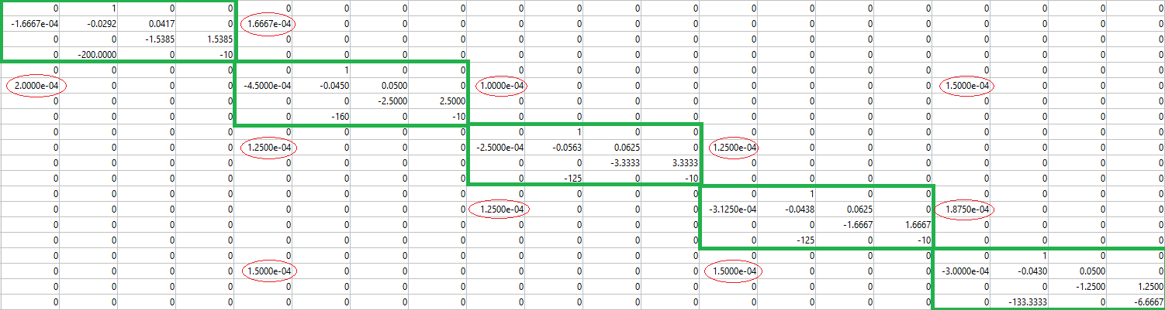
System Decomposition
Each area has well defined input and output. The system can be divided in 5 subsystems, each one corresponding to only one area.
This way, all components of u and y belong to a different subsystem, and all 5 of them have a distinct input and a distinct output.
Moreover, by analyzing matrix A, the interactions between the states of different areas take a very low, yet non-null, value (red circles) that will be ignored in the decomposition process, but taken into account for distributed control.

Slide 5
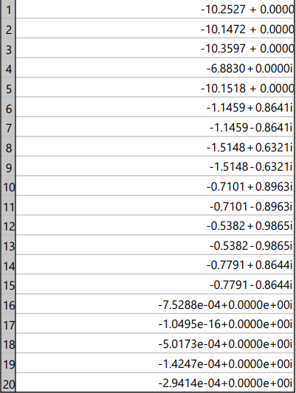
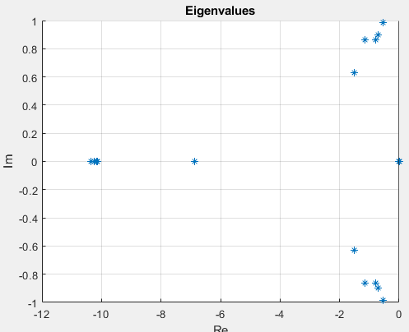
Open-loop analysis I Continuous time system
The eigenvalues of the system are computed:
As shown in the figure, one of the eigenvalues is on the imaginary axis. Therefore, the open-loop system is not asymptotically stable (only simply stable).

Slide 6
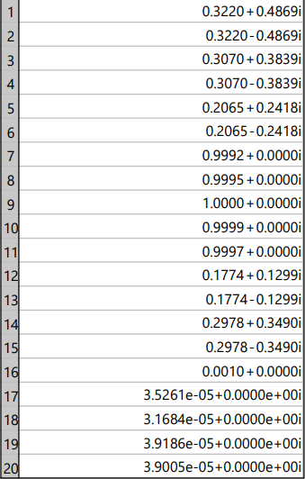
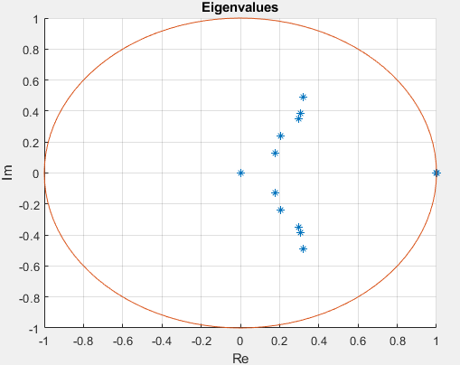
Open-loop analysis II Discrete time system
The corresponding discrete time system is obtained:
[F,G,H,L,h]=ssdata(c2d(ss(A,B,C,[]),h))
The eigenvalues are computed:
Like in the continuous case, one of the eigenvalues is on the unitary circle. Therefore, the discretized system is not asymptotically stable (only simply stable).

Slide 7
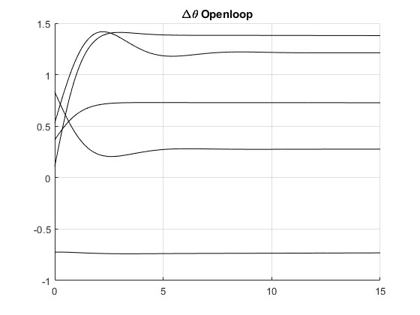
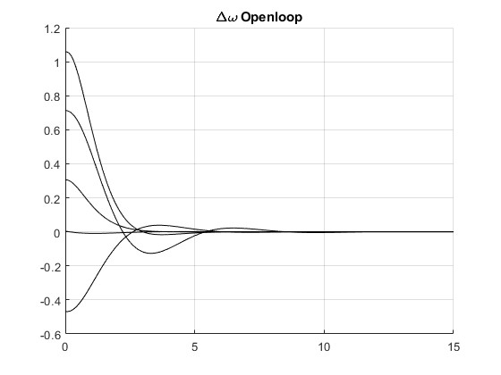
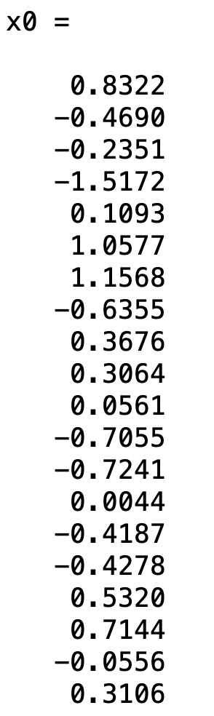
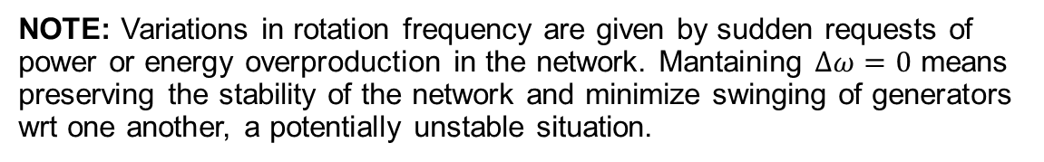
Open-loop analysis II Free Motions
The state motions that depict the simply stable properties of the system are the ones related to the deviation of the angular displacement of the rotor. The other states display an asymptotically stable behaviour. However, the simply stable nature of the system will inevitably affect the whole system, and needs to be corrected.
NOTE: Variations in rotation frequency are given by sudden requests of power or energy overproduction in the network. Mantaining $∆ω=0$ means preserving the stability of the network and minimize swinging of generators wrt one another, a potentially unstable situation.

Slide 8
Titolo presentazione sottotitolo
Milano, XX mese 20XX
Control Structures

Slide 9
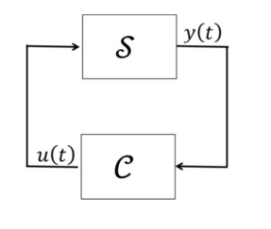
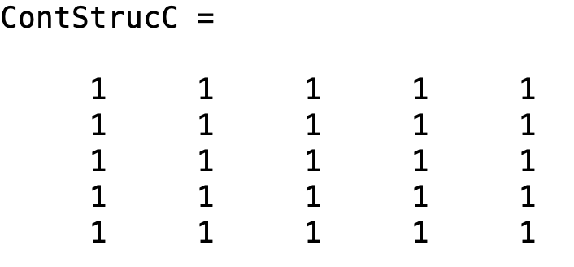
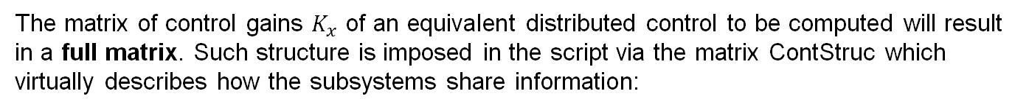
Centralized Structure
A state-feedback controller of the following structure is considered:
Such controller considers all states of the full system and tries to control them all at once. This way one can avoid tracking the interactions between the many subsystems
The matrix of control gains $K_{x}$ of an equivalent distributed control to be computed will result in a full matrix. Such structure is imposed in the script via the matrix ContStruc which virtually describes how the subsystems share information:

Slide 10
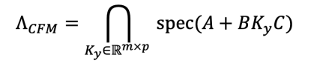
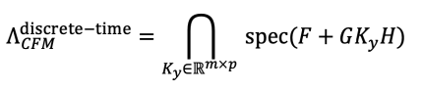
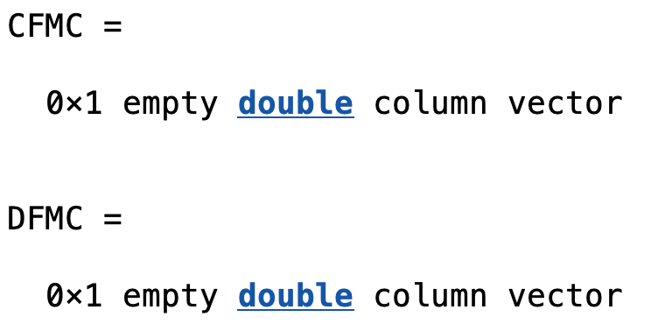
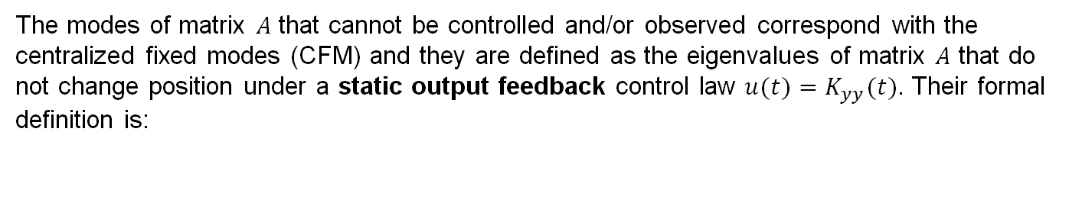
Centralized Structure Centralized Fixed Modes
The modes of matrix 𝐴 that cannot be controlled and/or observed correspond with the centralized fixed modes (CFM) and they are defined as the eigenvalues of matrix 𝐴 that do not change position under a static output feedback control law $u(t)=K_{yy}(t)$. Their formal definition is:
Note: other modes can be placed at will with a state feedback control law $u\left(t\right)=K_{xx}\left(t\right)$ as in the case under examination
The function di_fixed_modes shows that the system displays no centralized fixed modes, both in CT and DT (as expected).

Slide 11
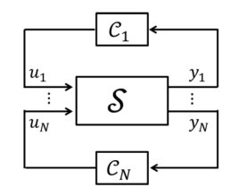
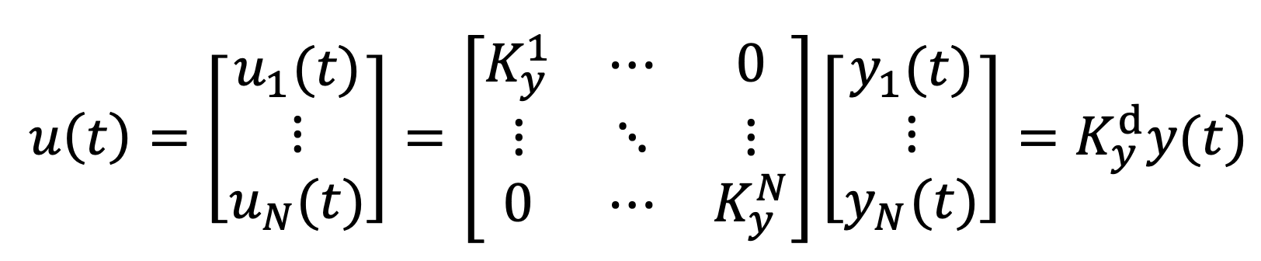
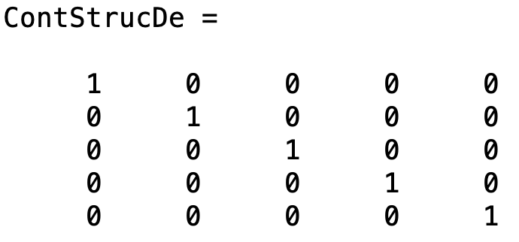
Decentralized Structure
In a decentralized structure each subsystem has its own controller C$i$ acting on $u_{i}$to control $y_{i}$, but no communication is implemented among the controllers.
The non-zero diagonal shows how only self loops are implemented in the 5 subsystems and no communications (out-of-diagonal terms) are present.

Slide 12
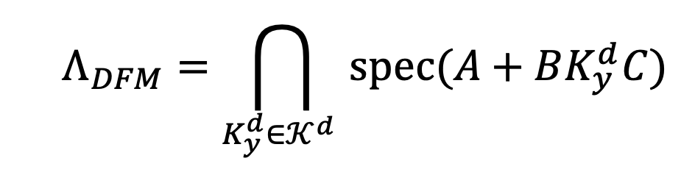
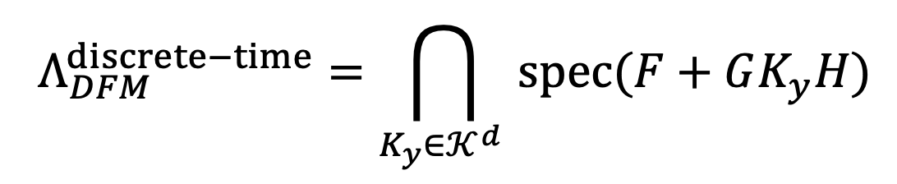
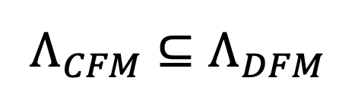
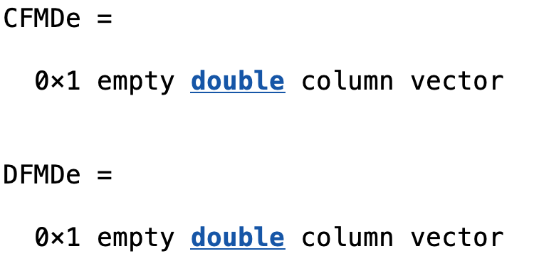
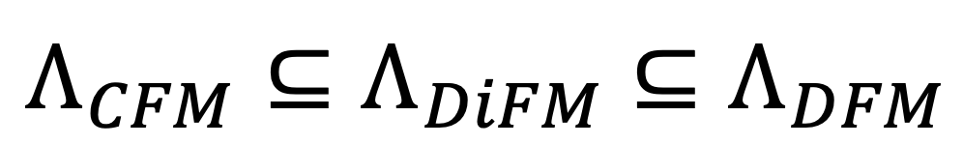
Decentralized Structure Decentralized Fixed Modes
Note :
as gain matrix is constrained to be block diagonal (new fixed modes may arise as there are less DoF-s for control)
The function di_fixed_modes shows that the system displays no decentralized fixed modes, both in CT and DT, so the loss of DoF-s did not affect critically the system
From this result no fixed modes can be expected for the distributed structure as well. This is obvious since:

Slide 13

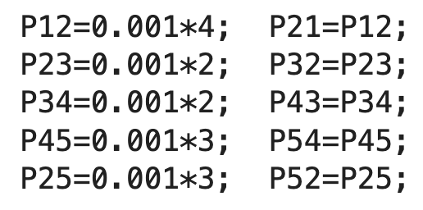
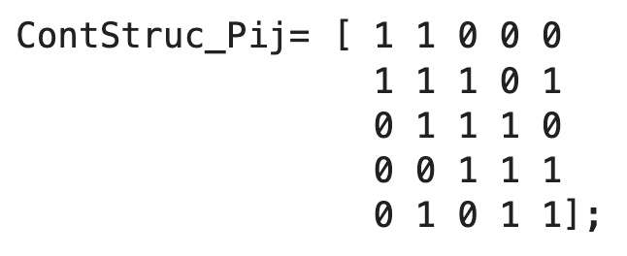
Distributed Structures Structure I
Physically Suggested Structure:
The study of the physical problem as suggested a structure to compensate the presence of the coupling terms Pij . Connections where made where such terms where present.
1
2
5
3
4

Slide 14
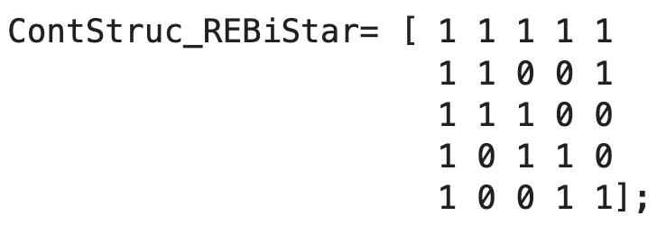
Distributed Structures Structure II
“Reinforced” Bidirectional Star :
An extension of the Bidirectional Star was developed, justified by the possibility to take a single area as the most important one (1st subsystem) while trying to keep a certain level of stability on the rest of the system in case of fault occurring on the master node.
2
5
1
3
The “Reinforcement” was carried out with single end connections in order to maintain a low number of interactions in the structure
4

Slide 15
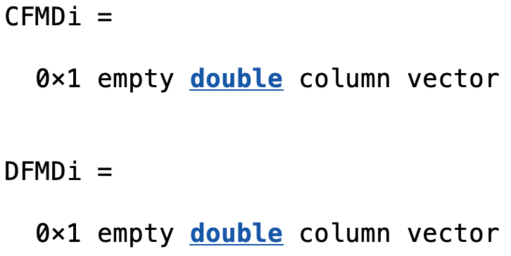
Distributed Structures Distributed Fixed Modes
The function di_fixed_modes shows that the system displays no distributed fixed modes, both in CT and DT just as expected. Such result is valid for the two implemented structures as for every other possible distributed structure.
In conclusion one can say that it should be possible to move the eigenvalues and confine them in a specific region for every configuration using a static state feedback control law.

Slide 16
Titolo presentazione sottotitolo
Control Implementation
Milano, XX mese 20XX

Slide 17
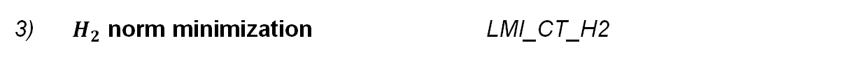
Control Strategies
To design a control gain $K_{x}$ that guarantees Hurwitz/Schur stability and some specific performance, one or more Linear Matrix Inequalities (LMIs) have to be enforced..
For all cases in both frameworks (centralized, decentralized and distributed, CT/DT) three main LMIs have been implemented:
1) Stabilizing LMI_CT_DeDicont
2) Eigenvalues in delimited region + alpha stability + minimization of control effort
*
LMI_CT_REG_ALPHA_MINU
3) $H_{2}$ norm minimization LMI_CT_H2
* Later referred to as «Multi-Objective LMI»

Slide 18
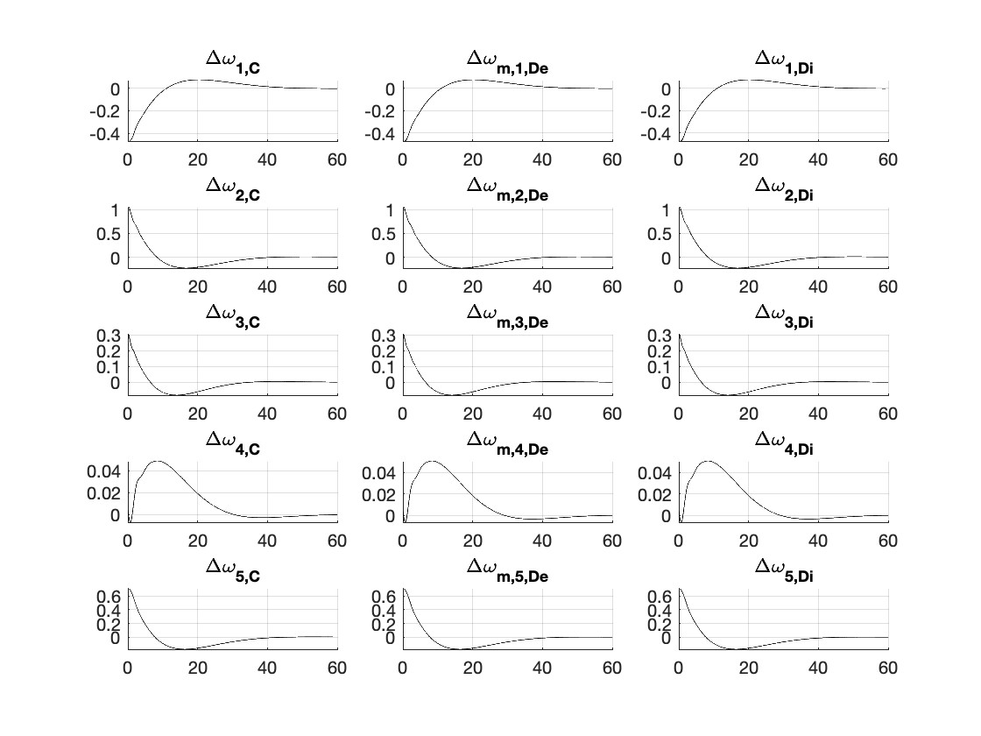
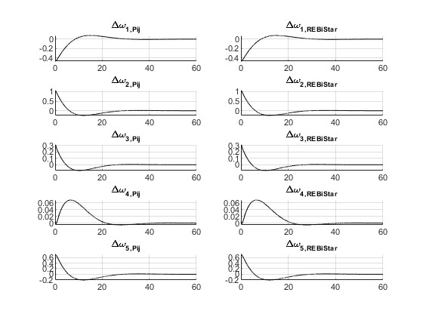
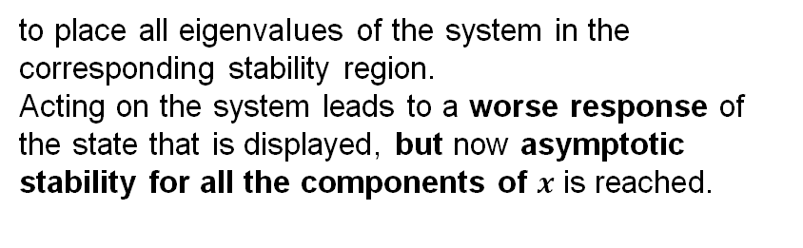
Stabilizing LMI
The stabilizing LMI implements the following constraint:
to place all eigenvalues of the system in the corresponding stability region.
Acting on the system leads to a worse response of the state that is displayed, but now asymptotic stability for all the components of $x$ is reached.
The dynamic of the states is identical in all configurations: this highlights very low coupling between the areas.

Slide 19
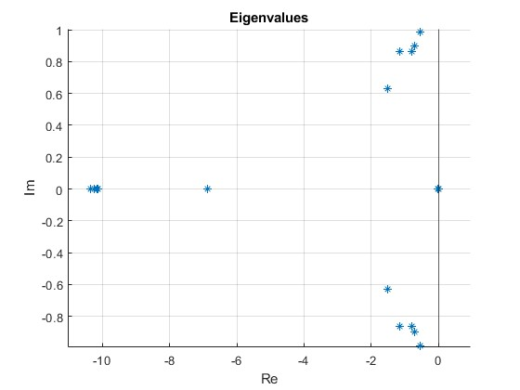
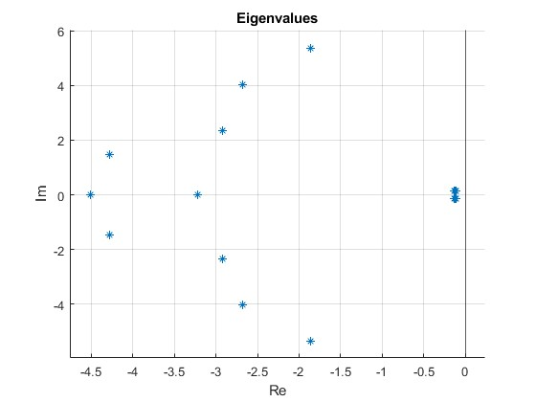
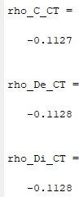
Stabilizing LMI Results Comparison
The dynamic of the states is much slower than before: using a stabilizing LMI the position of all the eigenvalues is changed (not only the problematic ones).
Eig(A)
Eig(A+B*K_C_CT)
The resulting spectral abscissas (and later spectral radius) achieved are basically the same for all control structures:

Slide 20
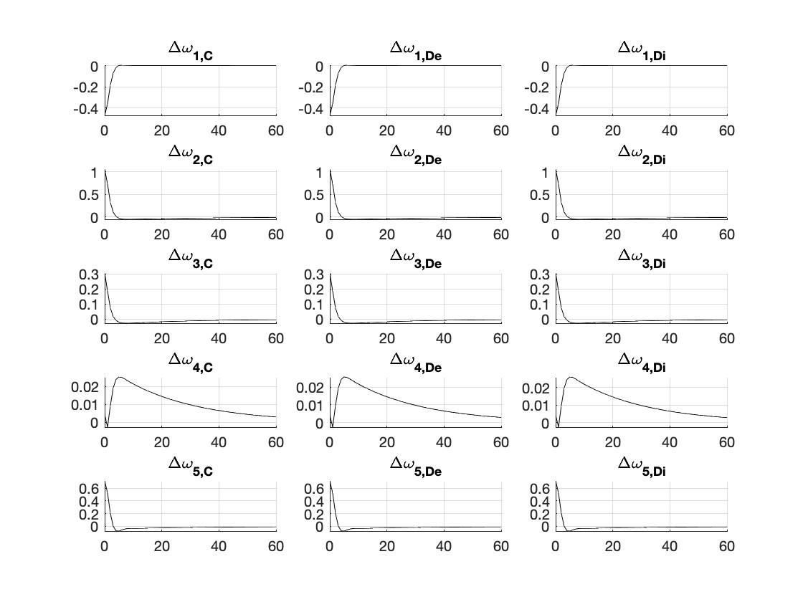
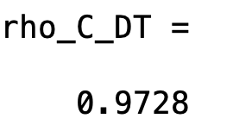
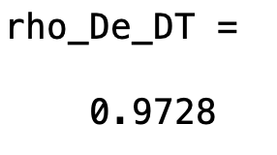
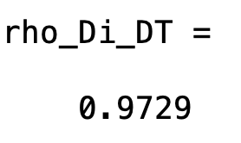
Stabilizing LMI Discrete Time
As expected, the same similarities between different structures are obtained in the discrete time framework.
One can conclude the presence of very low interaction between the areas since:
changing distributed structure has little effect on performance
In general results stay the same
On the other hand, connections can still be useful in non-standard cases: e.g. in presence of failures, much higher demand than expected, maintenance needs…

Slide 21
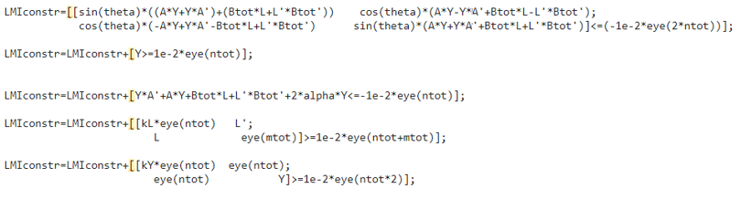
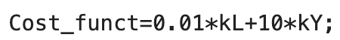
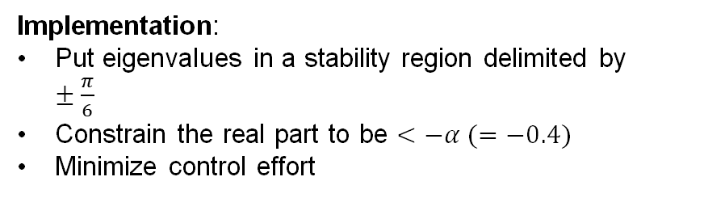
Multi_objective LMI Continuous Time
Goals:
Limit oscillations
Get faster response
Still obtain feasible control action
Implementation:
Put eigenvalues in a stability region delimited by $±\frac{π}{6}$
Constrain the real part to be $<−α (=−0.4)$
Minimize control effort
The LMI implemented is:

Slide 22
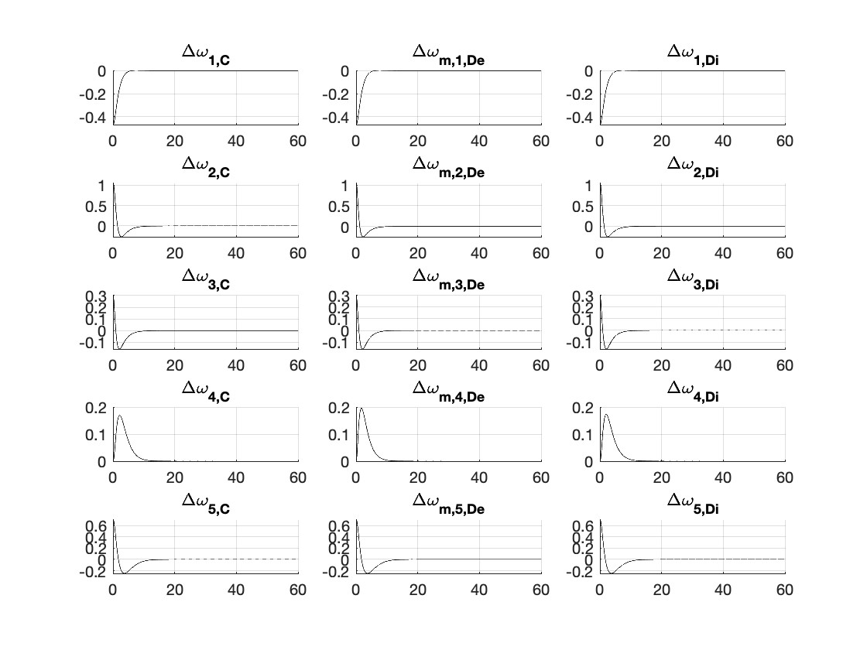
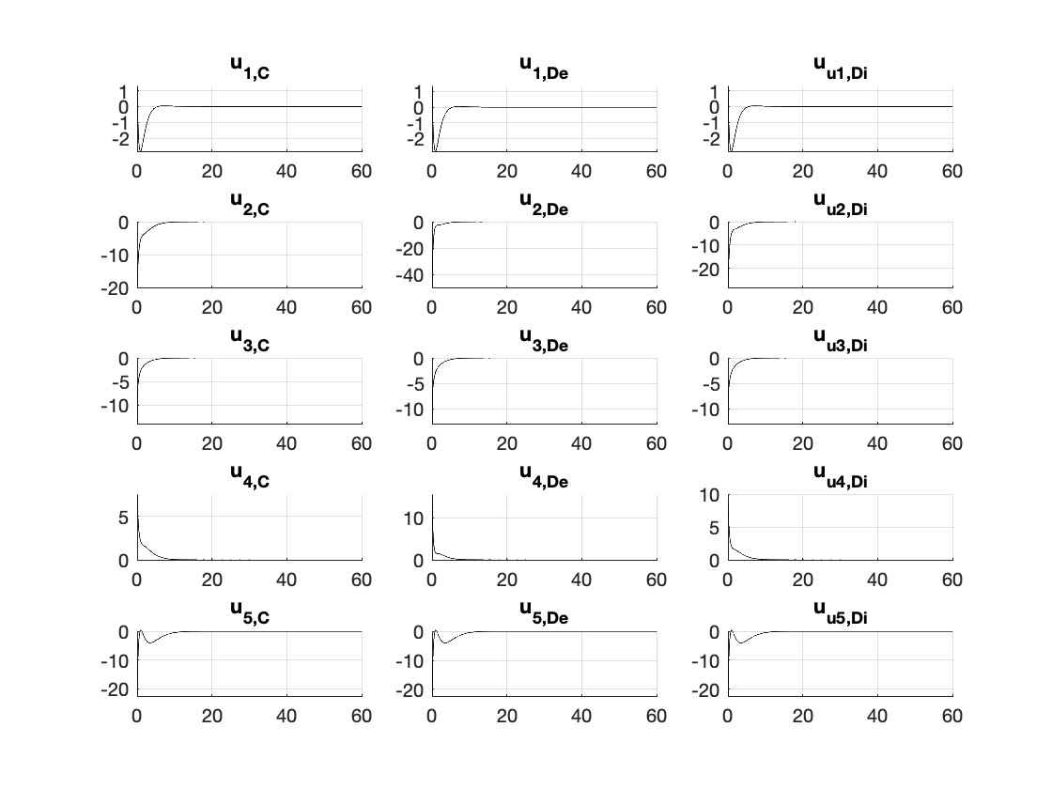
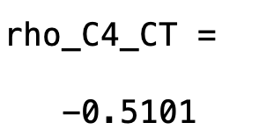
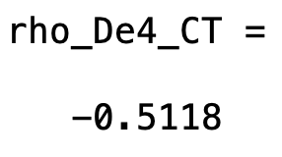



Multi_objective LMI Continuous Time: Results
Evolution of the states $Δω_{i}$in centralized, decentralized and distributed schemes.
Control action: it seems to not succeed in minimizing $u$ at the very first instant.

Slide 23

Multi_objective LMI Discrete Time
Goals:
Reduce oscillations and avoid sign changes
Obtain a feasible deviation from nominal power setpoint (i.e. the subsystem input)
Implementation:
Eigenvalues in a disk on the right half of the stable region
Minimization of control effort
The LMI implemented is:

Slide 24






Multi_objective LMI Discrete Time: Results
Evolution of the states $Δω_{i}$in centralized, decentralized and distributed schemes
Control action: it presents a better behaviour than the CT counter part

Slide 25





$ℋ_{2}$ norm minimization LMI
The generalized plant structure is considered:
Where z is a weighted function of both states and input.
As in LQ, selecting the values inside matrices $C_{z}$ and $D_{z}$determines the prevailing optimization direction (minimization of state deviation vs control input).
Goals:
Minimize the 2-norm of the transfer function $G_{zw}(s)$
In particular, by imposing:
and selecting appropriate weights $q_{i}$ and $r_{i }$the focus is on a specific state/input during the optimization
The noise matrix $B_{w}$ is considered to be an identity matrix to account for nonlinearities and uncertainties in the model (uncertainty on each state of the system).
B_w = eye(20)

Slide 26

$ℋ_{2}$ norm minimization LMI
How should Q and R be chosen?
Simplest choice: $Q = I, R=ρI$. $ρ$ is varied to get a good response
Diagonal weights:
$Q=\left[\begin{matrix}q_{1} & & \\ & ⋱ & \\ & & q_{n} \end{matrix}\right] R=ρ\left[\begin{matrix}r_{1} & & \\ & ⋱ & \\ & & r_{m}\end{matrix}\right]$
$q_{i}$ and $r_{j}$ are chosen such as to give equal effort for same «badness».
$\frac{1}{60} rad$ error is OK $⟹q_{1}={\left(60\right)}^{2}$ $q_{1}x_{1}^{2}=1 when x_{1}=\frac{1}{60}rad$
$1 p.u.$ error is OK $⟹q_{3}={\left(1\right)}^{2} q_{3}x_{3}^{2}=1 when x_{3}=1 p.u.$
So: q = [60^2 0 0 0; 0 60^2 0 0; 0 0 1 0; 0 0 0 1]
Q = blkdiag(q, q, q, q, q)
R = eye(5)

Slide 27


$ℋ_{2}$ norm minimization LMI
To sum up:
In order to achieve a $ℋ_{2}$ norm minimization the following LMI is implemented:
$$AY+BL+YA^{T}+L^{T}B^{T}+B_{w}B_{W}^{T}<0$$
$$\left[\begin{matrix}S & CY+DL \\ {\left(CY+DL\right)}^{T} & Y\end{matrix}\right]≥0$$
With cost function: $J=trace(S)$
$B_{w}=I$

Slide 28

$ℋ_{2}$ simulations – Centralized Structure

Slide 29

$ℋ_{2}$ simulations – Decentralized Structure

Slide 30

$ℋ_{2}$ simulations – Distributed I Structure

Slide 31

$ℋ_{2}$ simulations – Distributed II Structure

Slide 32

$ℋ_{2}$ simulations
As expected, it can be observed that:
When $ρ$ is big, control weight is higher, so the optimization focuses on limiting the control action, with the guarantee of convergence with a slower dynamic. This conservative condition allows to have no overshoot, but it slows down the system considerably.
When $ρ$ is small, control weight is smaller, so the optimization puts more control effort to speed up convergence (though we don’t exaggerate the request, so that the control action is still acceptable). It is a little bit faster than the previous case, but there are more visible over/undershoot . In this case the control action is much less limited.
The case $ρ=2$ is a good compromise.
Remark: The different structures present a very similar movement. Therefore, there is not a «better» control structure when it comes to $ℋ_{2}$ control.

Slide 33

$ℋ_{2}$ simulations – Discrete Time

Slide 34
Titolo presentazione sottotitolo
Milano, XX mese 20XX
Conclusions

Slide 35
Conclusions
The simply stable system results easily stabilizable in all cases with an LTI state feedback controller thanks to the absence of fixed modes.
Different control strategies lead to different advantages:
The Multi-Objective LMI works best for performance improvements. It allows us to move the poles in order to prescribe the overall dynamic and at the same time keep an eye on the control effort.
A H2 norm LMI can generate an optimal gain matrix according to the best control/state trade-off.
The variation of the Distributed Control Structure has a minimal effect on the system, yet its optimization may be necessary for critical operations such as maintenance or fault management.

Slide 36
Titolo presentazione sottotitolo
Thanks for the attention
Milano, XX mese 20XX

